Slide 1

Diversity
Laura McDonnold
Ashford University

Slide 2

What exactly is diversity?

Slide 3
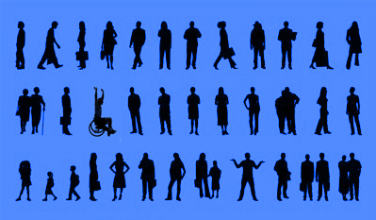
Definition of Diversity
The concept of diversity encompasses acceptance & respect.
It means understanding that each individual is unique, & recognizing our individual differences.

Slide 4
Definition of Diversity
These can be along the dimensions of:
Race
Ethnicity
Gender
Sexual Orientation
Socio-Economic Status
Age
Physical Abilities
Religious Beliefs
Political Beliefs
Or Other Ideologies

Slide 5

Definition of Diversity
It is the exploration of these differences in a safe, positive, & nurturing environment.
It is about understanding each other & moving beyond simple tolerance to embracing & celebrating the rich dimensions of diversity contained within each individual.

Slide 6

Diversity brings real benefits
to society & businesses.

Slide 7

Diversity Brings Real Benefits
To Society
For society, diversity brings richness & variety. There are always new & interesting things to be learned from each other.

Slide 8

Diversity Brings Real
Benefits to Businesses
For a business, employing a diverse workforce enables it to use a wider range of talents & skills.

Slide 9
Diversity Brings Real
Benefits to Businesses
These lead to creativity & innovation. Businesses need to mirror the communities & cultures they work in so they can understand & anticipate the diverse needs of their customers.

Slide 10

Diversity Brings
Real Benefits
to Businesses
In order to get the best from staff & meet the varying needs of their diverse customers, it is
very important for businesses to manage diversity in a positive way.
They need to recognize, respect & value people’s differences.

Slide 11

Diversity
Brings
Real Benefits
to Businesses
People are an organization’s number one asset, so administration should do what they can to keep valuable skills & talent.
A mix of people with different talents, skills, and perspectives allows creativity and innovation to develop.
Organizations need to appeal to the widest possible number of people to fulfill its recruitment needs & attract the skills it requires.
Organizations need to be able to manage a labor force that is becoming increasingly diverse, creating a culture of inclusion is essential to build a sustainable business for the future.
Employees who feel valued & respected are more likely to be highly motivated & committed to the organization. This means they are more likely to perform better & make a bigger contribution.

Slide 12
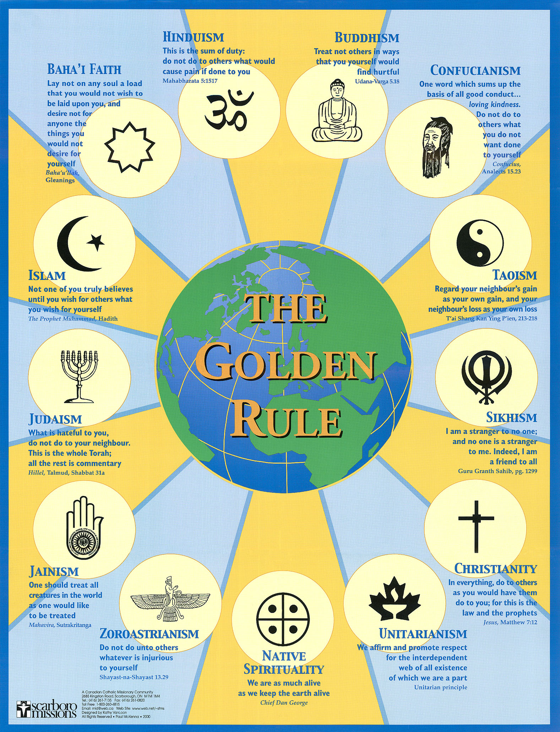
Let’s All Get Along!

Slide 13
References:
Definition: http://gladstone.uoregon.edu/~asuomca/diversityinit/definition.html
Benefits for Business: http://www.biznet.org.uk/Department%20of%20Trade%20and%20Industry%20-%20News%20Article_files/lloydstsb_12_full.pdf
The Golden Rule: http://images.google.com/images?gbv=2&hl=en&q=the+golden+rule

